Slide 1
Building Energy Consumption Forecast
Use Case Briefing
Internal

Slide 2
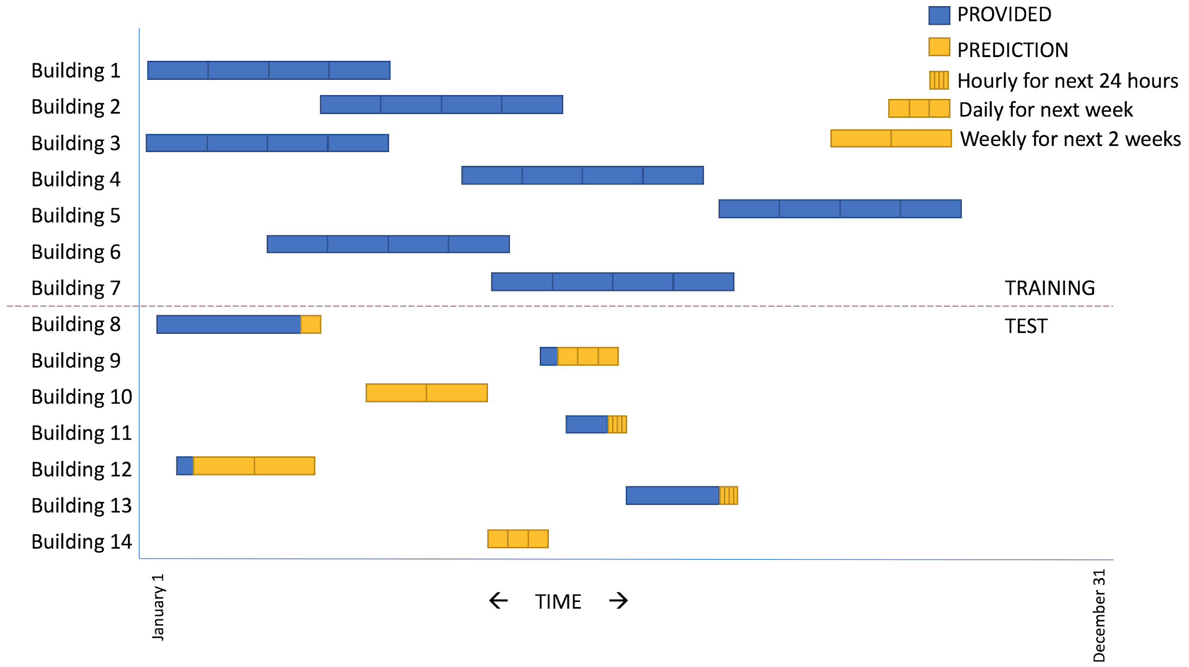
Use Case Overview
Background
Building energy consumption varies across a year, especially for countries in the temperate zones of the southern and northern hemispheres. With varying consumption comes varying demand, thus it becomes important for building managers to make better decisions to reasonably control all kinds of equipment. A well-managed, energy efficient building offers opportunities to reduce costs and reduce greenhouse gas emissions. However, as a result of randomness and noisy disturbance, it is not an easy task to realize accurate prediction of the building energy consumption.
Objective
The objective of this task is to forecast energy consumption based on temperature and other building information.
Three (3) time horizons for predictions are defined:
Forecasting the consumption for each hour in the next day (24 predictions).
Forecasting the consumption for each day in the coming week (7 predictions).
Forecasting the consumption for each week in the coming two weeks (2 predictions).
Key Skills
Data Wrangling, EDA, Feature Engineering, Regression, Time-series Forecasting
Internal

Slide 3
Data Overview
DATA PROVIDED
EXPECTED OUTPUT
Training Data.csv
Predictions.csv
Historical energy consumption and temperature data for different buildings.
series_id - An ID number for the time series, matches across datasets.
timestamp - The time of the measurement
consumption - Consumption (watt-hours) since the last measurement
temperature - Outdoor temperature (Celsius) during measurement from nearby weather stations, some values missing
A continuation of Test Data.csv.
series_id - An ID number for the time series, matches across datasets.
timestamp - The time of the measurement
consumption – Your Predictions Come Here
temperature - Outdoor temperature (Celsius) during measurement from nearby weather stations, some values missing
Building Metadata.csv
series_id - An ID number for the time series, matches across datasets
surface - The surface area of the building (ordinal)
base_temperature - The base temperature that the inside of the building is set (ordinal)
monday_is_day_off - Whether or not the building is operational this day
tuesday_is_day_off - Whether or not the building is operational this day
wednesday_is_day_off - Whether or not the building is operational this day
thursday_is_day_off - Whether or not the building is operational this day
friday_is_day_off - Whether or not the building is operational this day
saturday_is_day_off - Whether or not the building is operational this day
sunday_is_day_off - Whether or not the building is operational this day
Test Data.csv
Similar format as Training Data.csv. The consumption is expected to be forecasted.
Internal

Slide 4
Expected Outcomes
Output:
Predictions.csv
Presentation:
Data manipulation methodology
EDA (e.g. univariate/multivariate analysis, hypothesis testing)
Feature engineering
Modelling methodology (solution framework)
Train-test-split approach
Model evaluation results
Other techniques (e.g. clustering, dimension reduction)
Given extra time, what would you do next? (compulsory for all teams)
Remember, it’s not just about sharing your approach/results, but also why and how you did it!
Internal

Slide 5
Good Luck!
Internal

